Slide 1
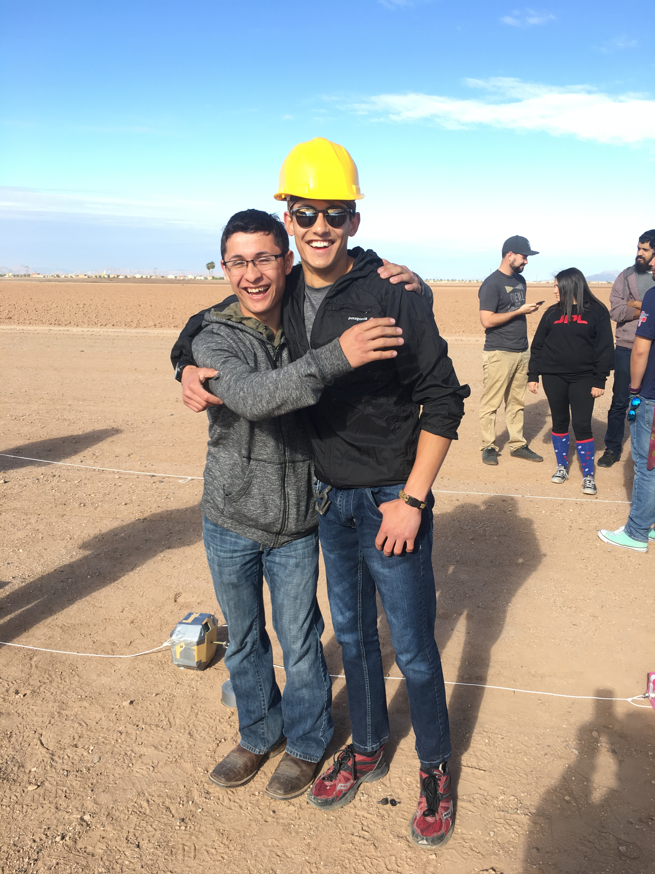



Construction of a low-cost high altitude balloon flight recording system with simultaneous collection of airborne particulates for SEM analysis
Pima Community College- West Campus
31 March, 2017
Team Members:
Alfredo Gonzalez
Tristian Simi
Mentor:
Dr. Silvia Kolchens

Slide 2
High level design approach
Low Cost
Off the shelf parts
Reusable
Survivable
Open source architecture
Notes:
build vs buy

Slide 3
OBJECTIVES
Atmospheric particle collection throughout flight
Aerodynamically efficient payload frame
Baseline temperature, altitude and pressure
Video projected at an angle
Notes:
why obtain sensor data? explain
why was video projected at angle?

Slide 4
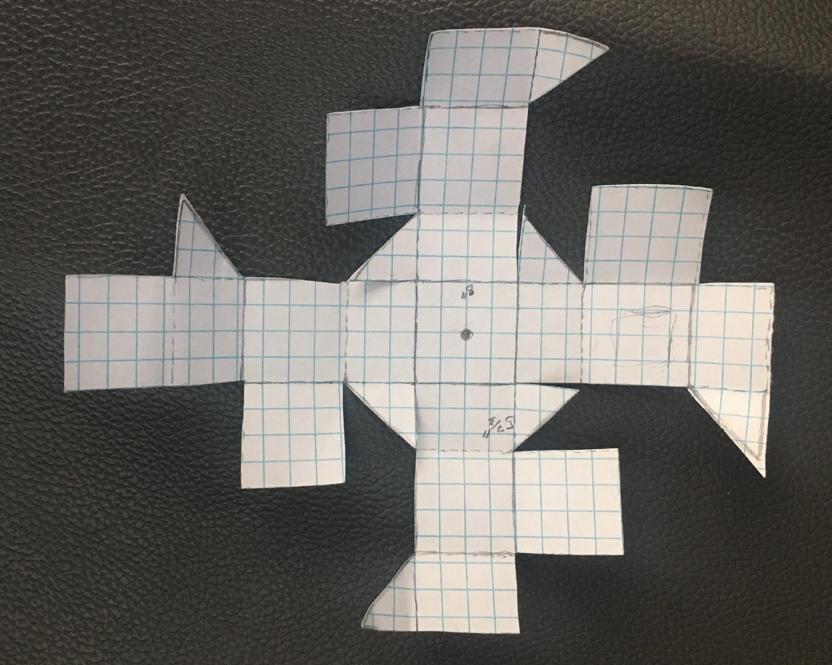
Payload Frame
One piece of foam poster board
Attempt to achieve aerodynamics similar to a sphere
Relatively high density compared to previous payloads

Slide 5
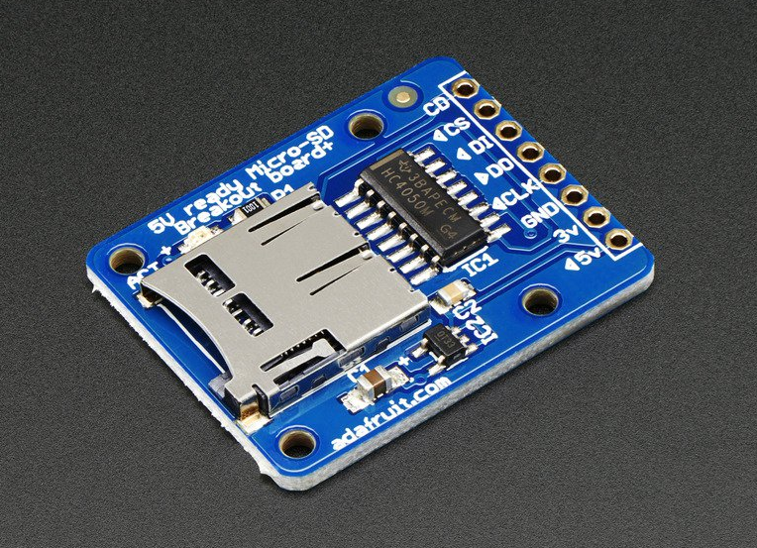
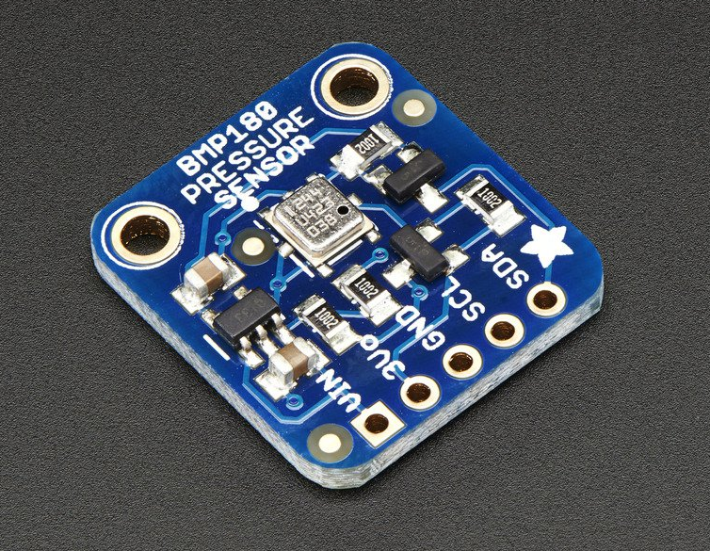
Recording Component
Completely recycled and used parts
Adafruit BMP180
Adafruit Micro USB Breakout
Arduino Uno

Slide 6
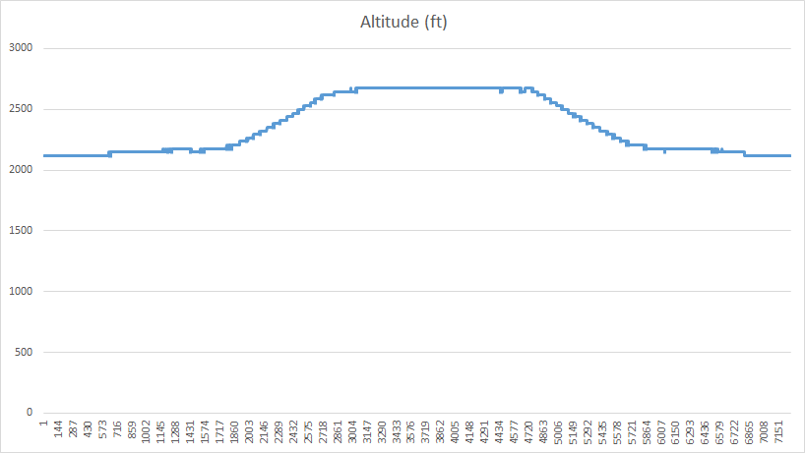
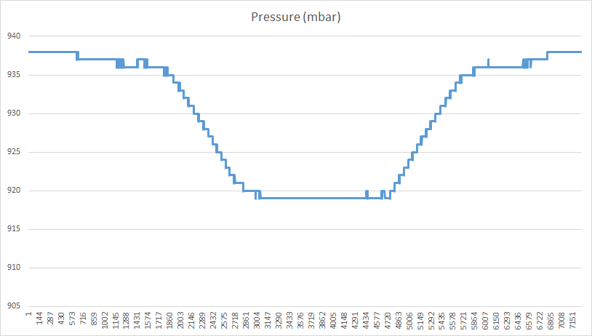
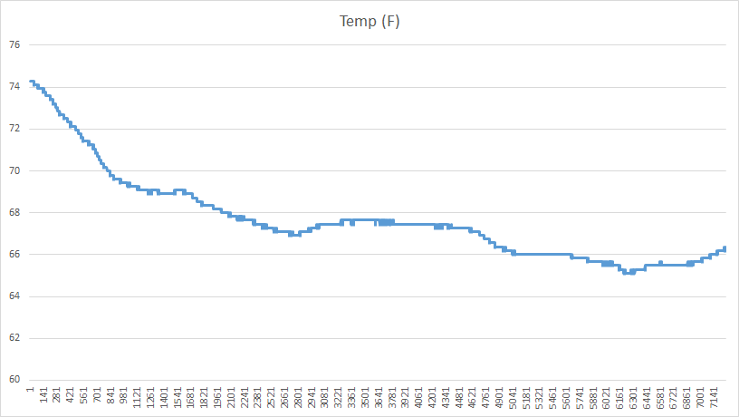
Recording Test
Notes:
converted to mbar

Slide 7
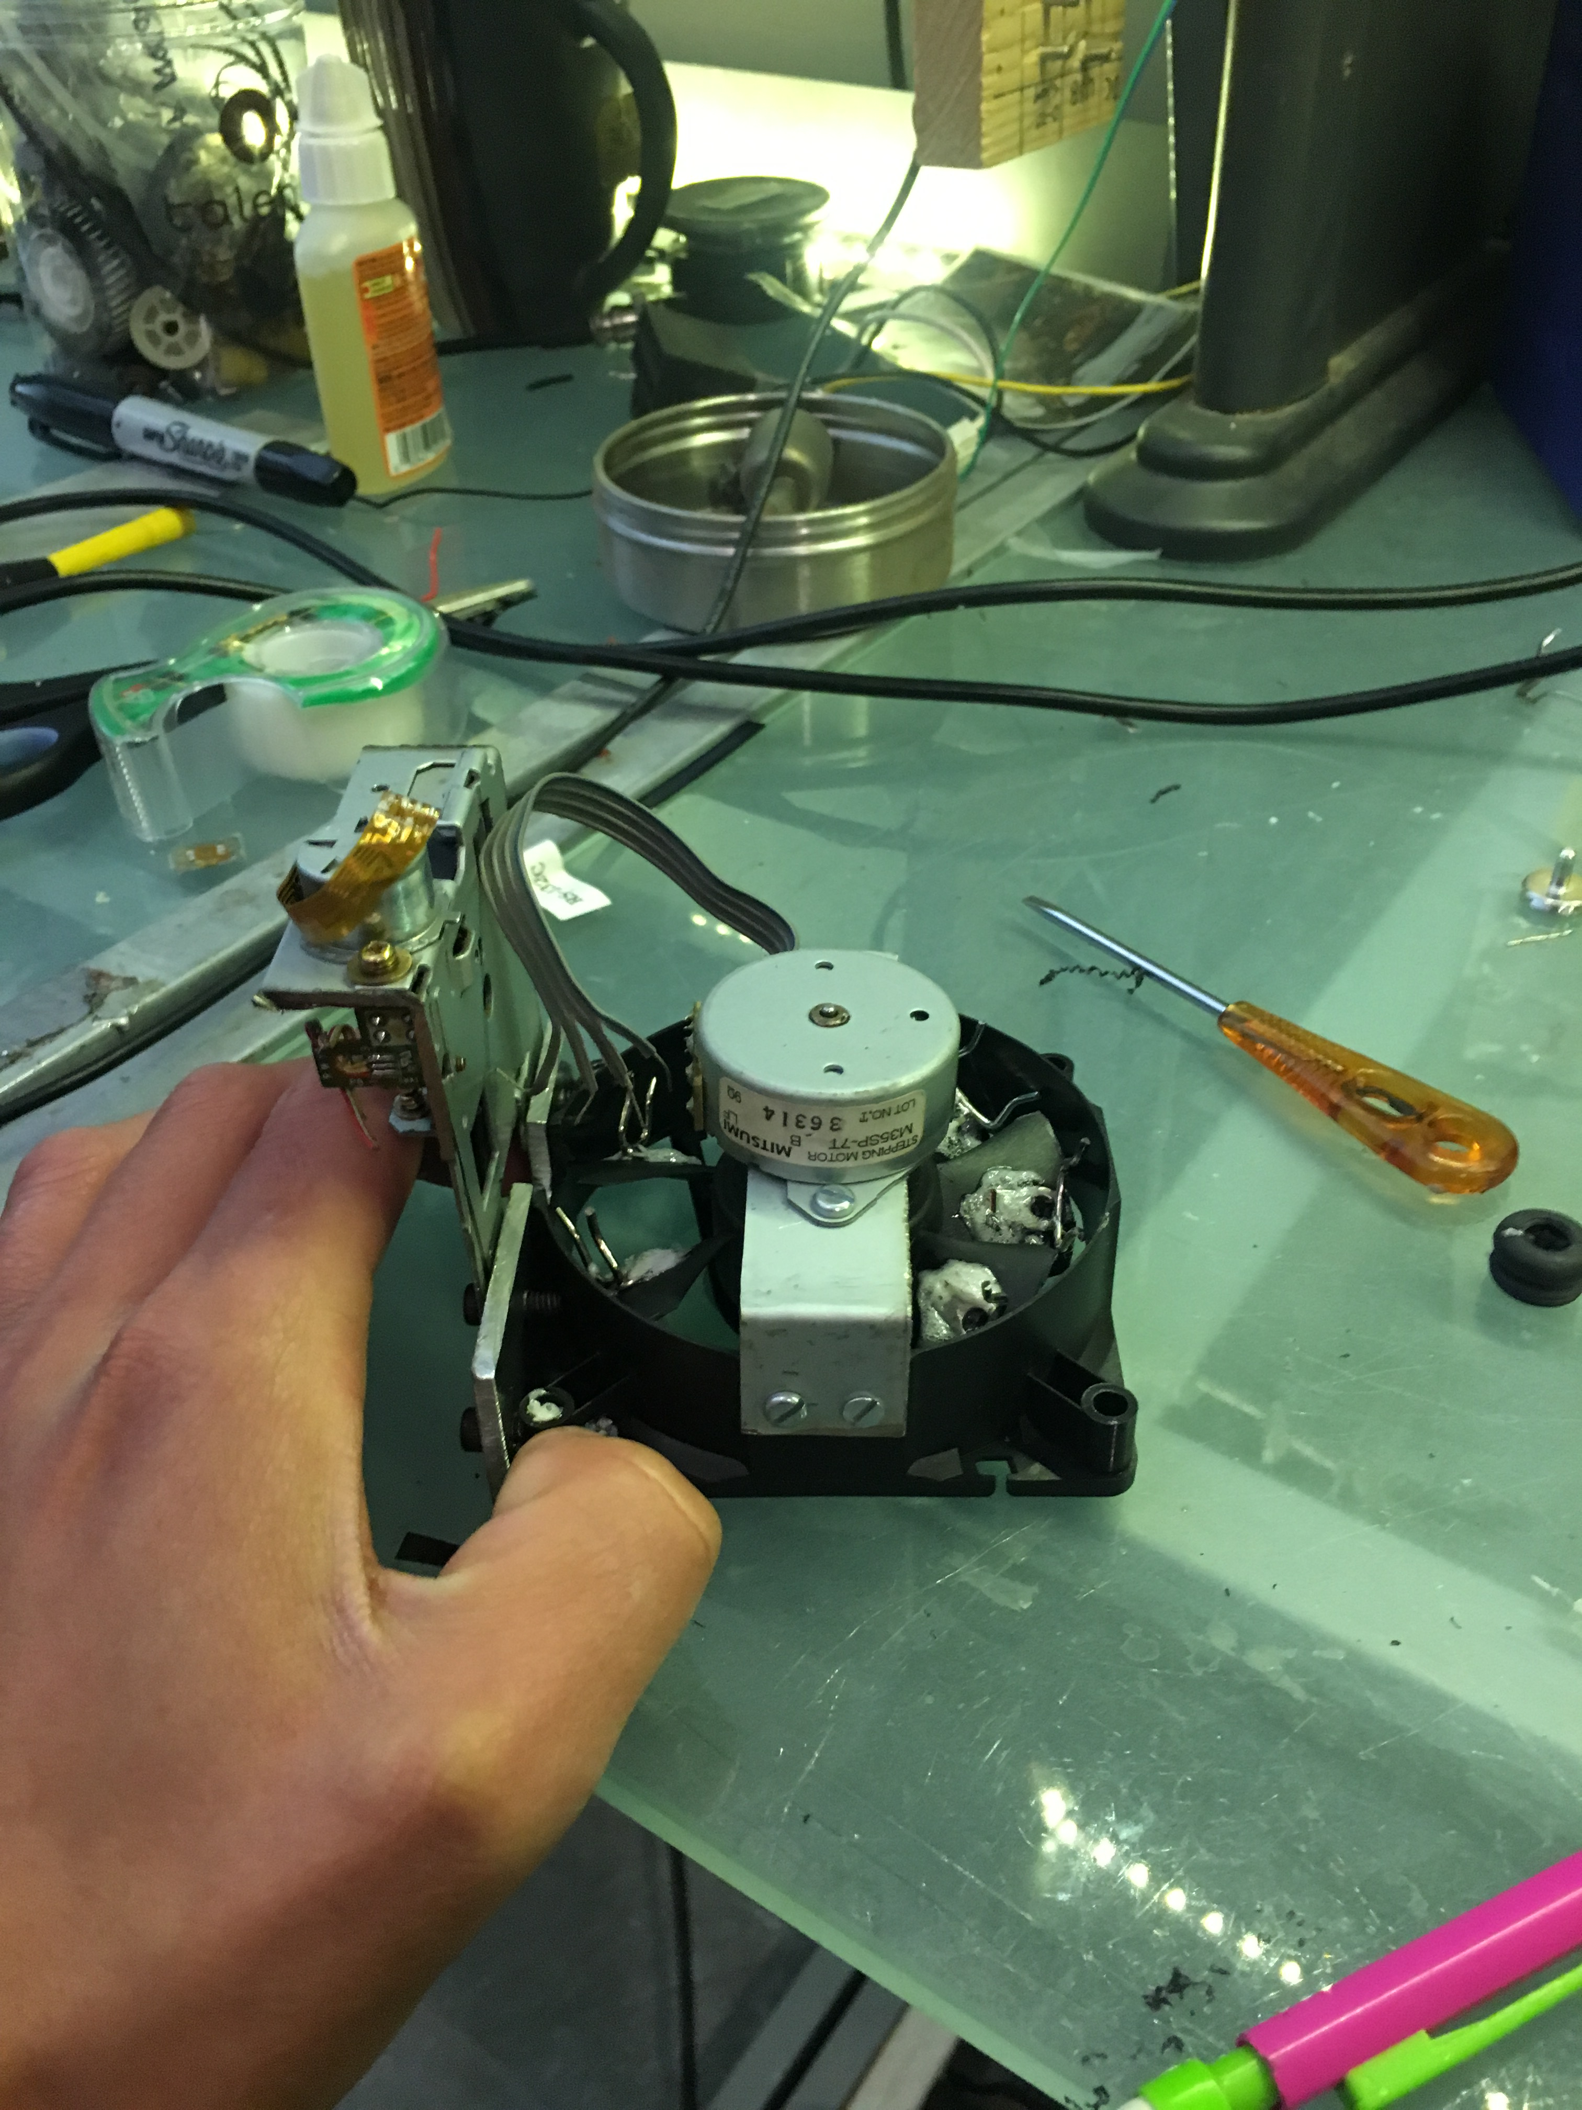
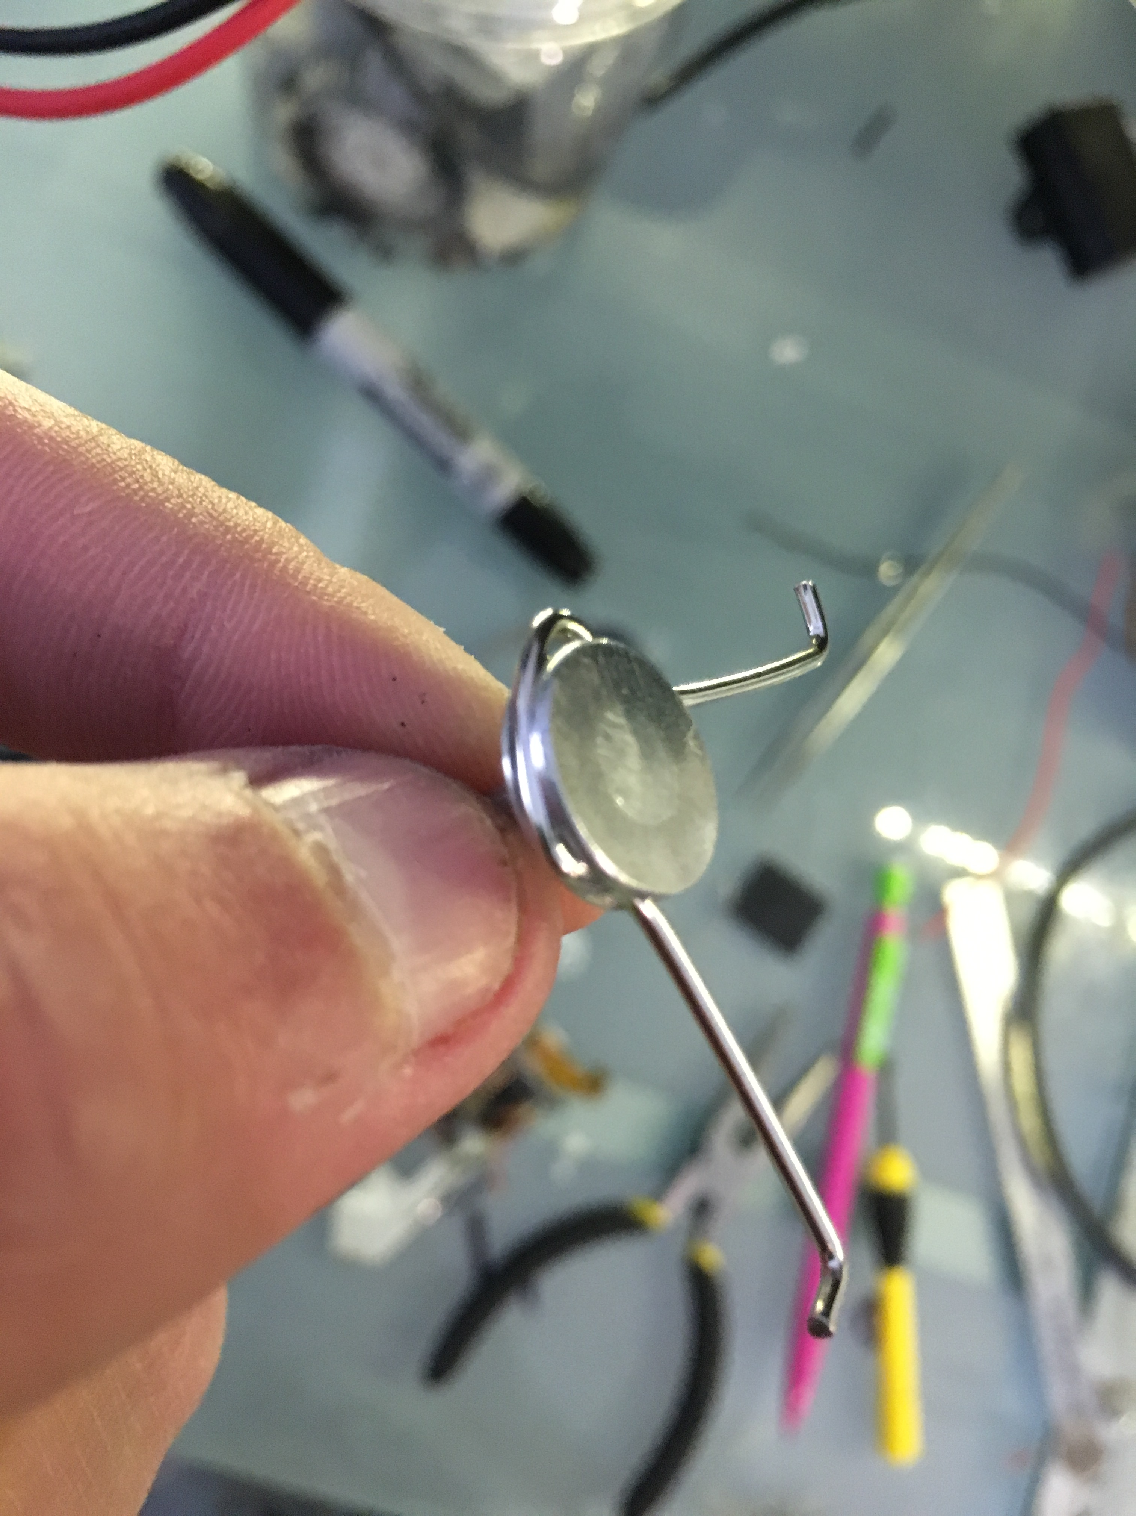
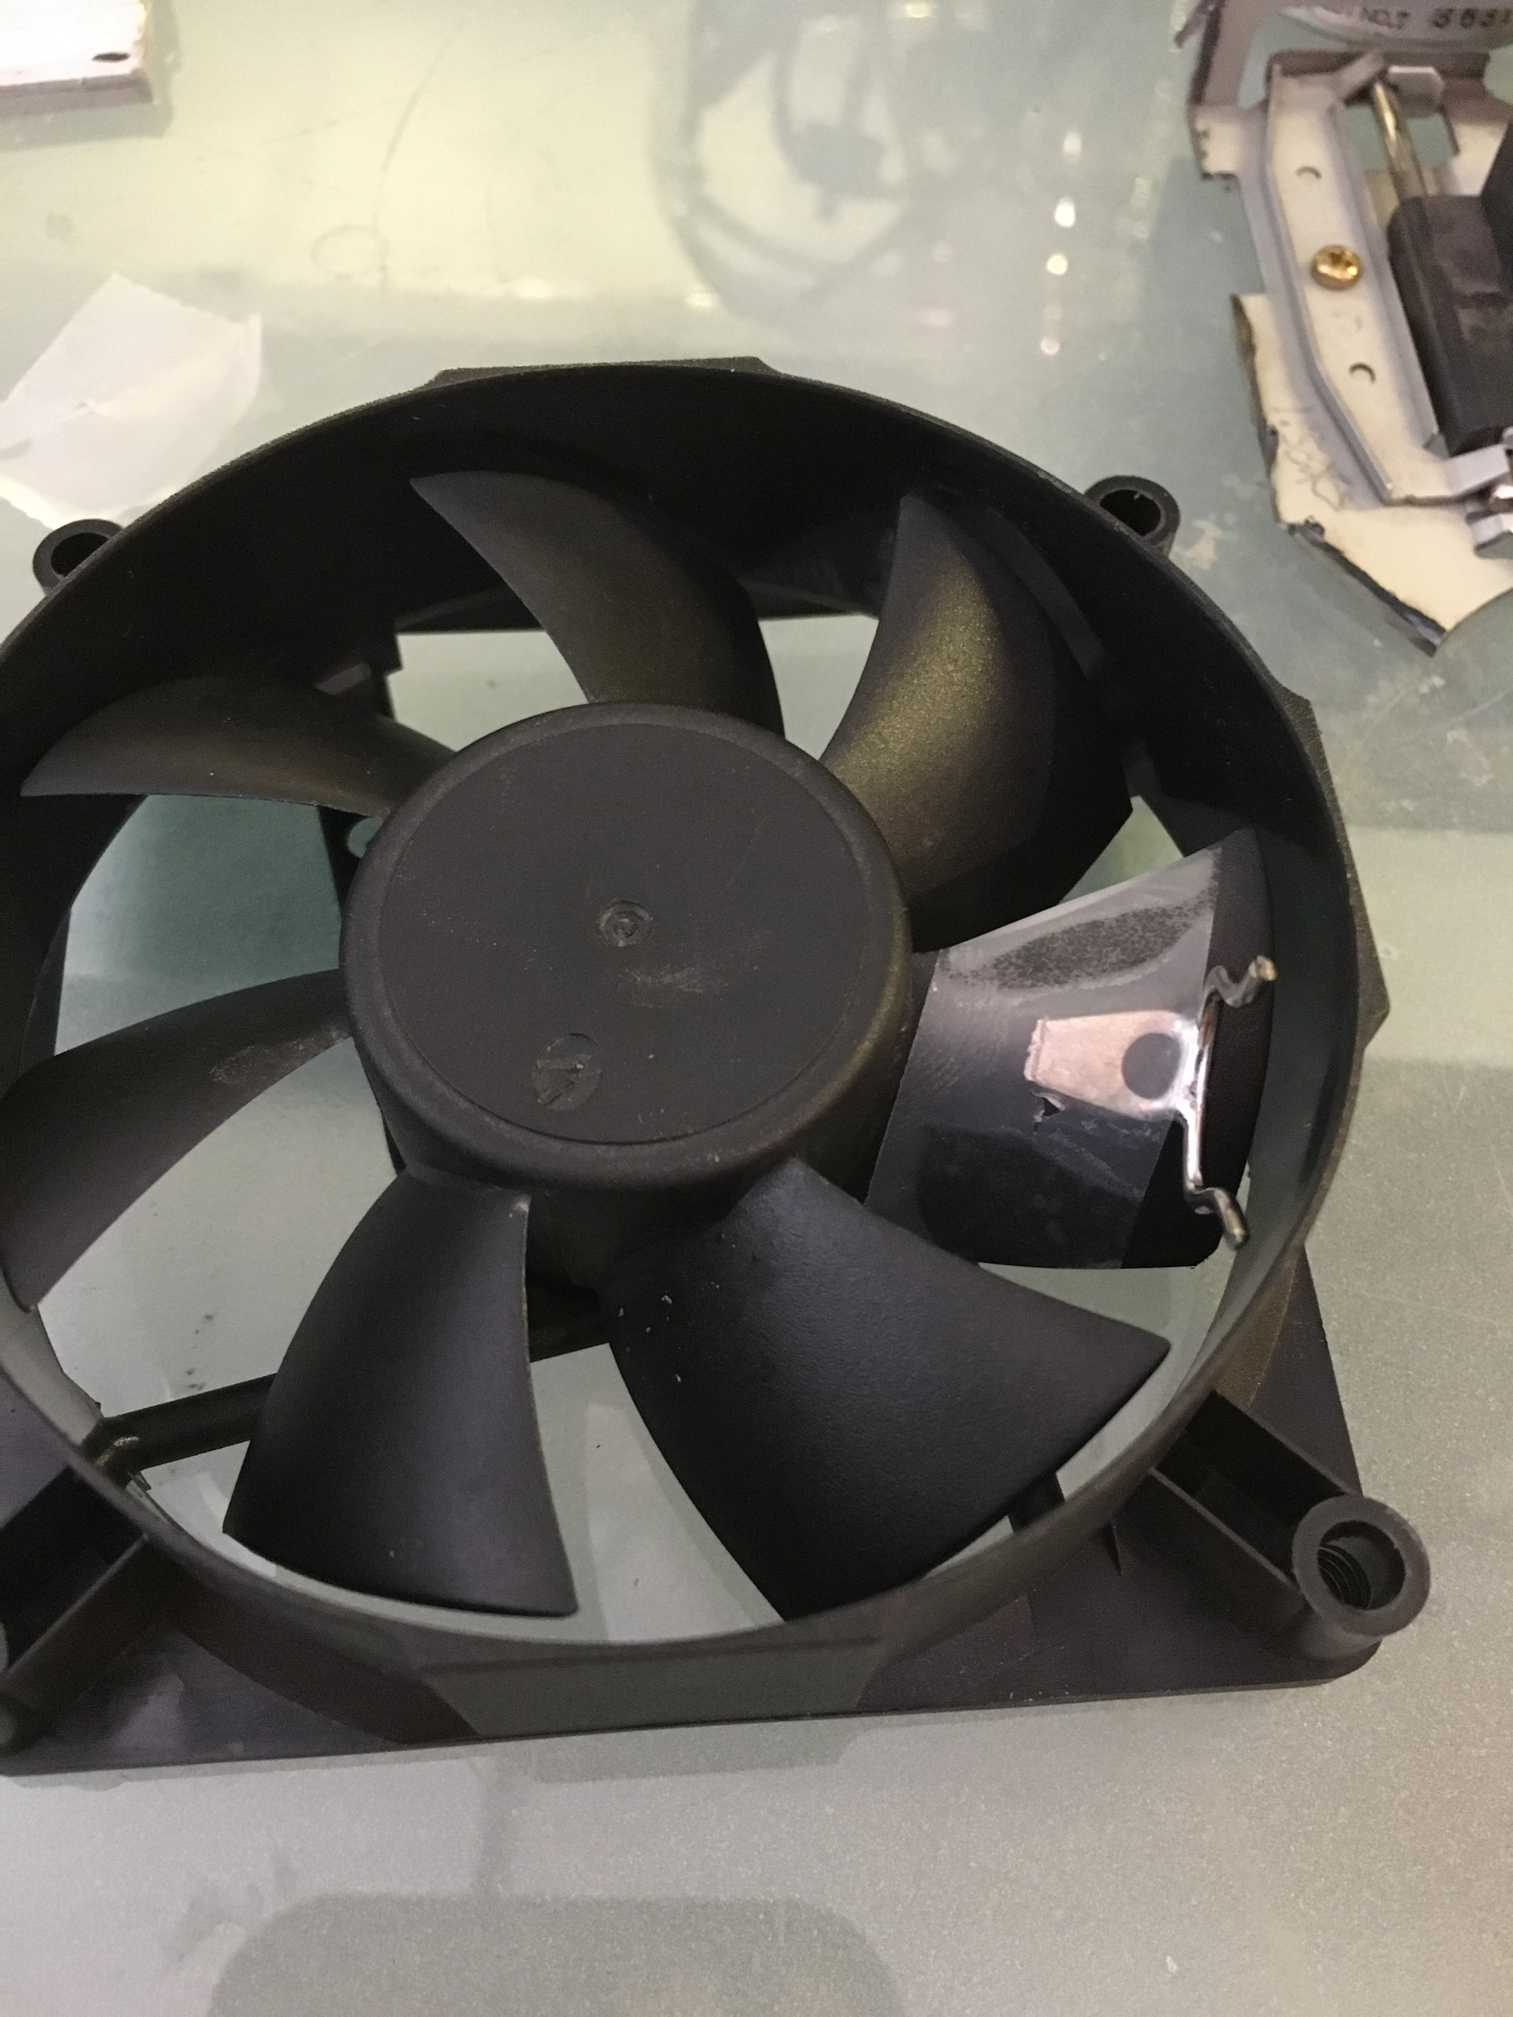
PARTICLE COLLECTION (specific objectives)
Ease of SEM tip change
Locking mechanism
7 samples through flight duration

Slide 8
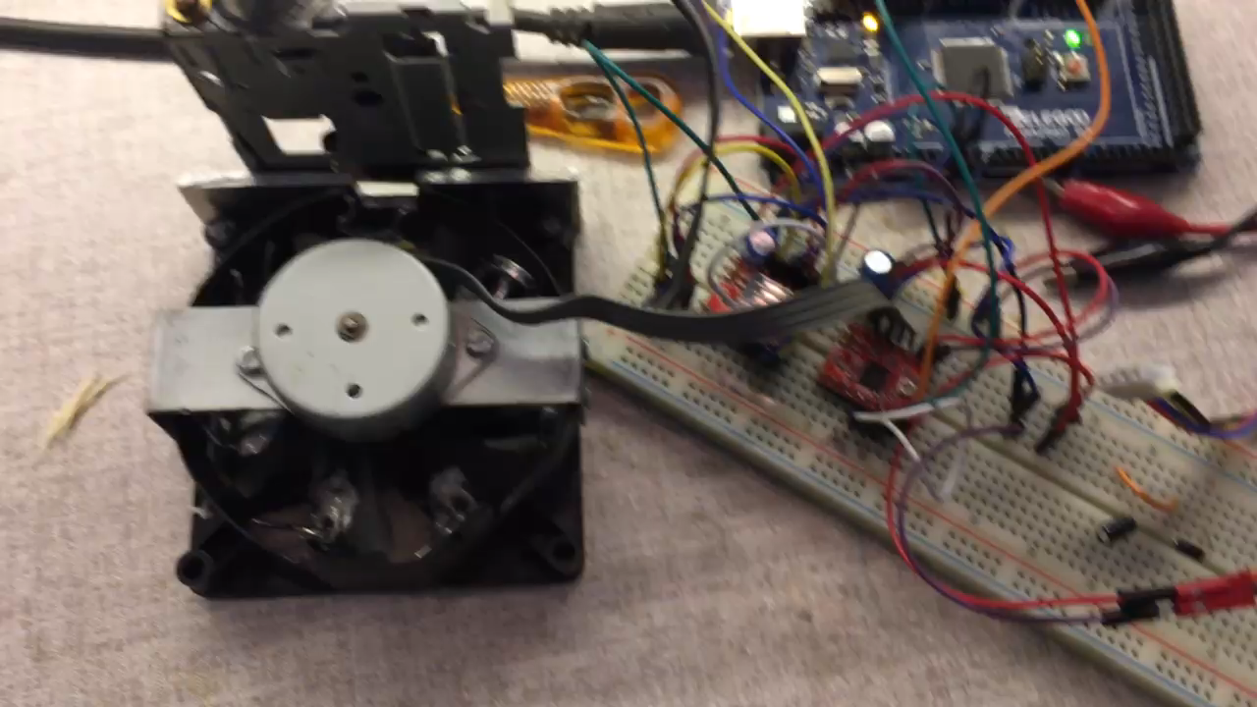
Particle Collection Unit (PCU)
PSU fan base
Stepper motor
Linear motion guide rail
SEM sample holders
Notes:
video feedback from go pro

Slide 9
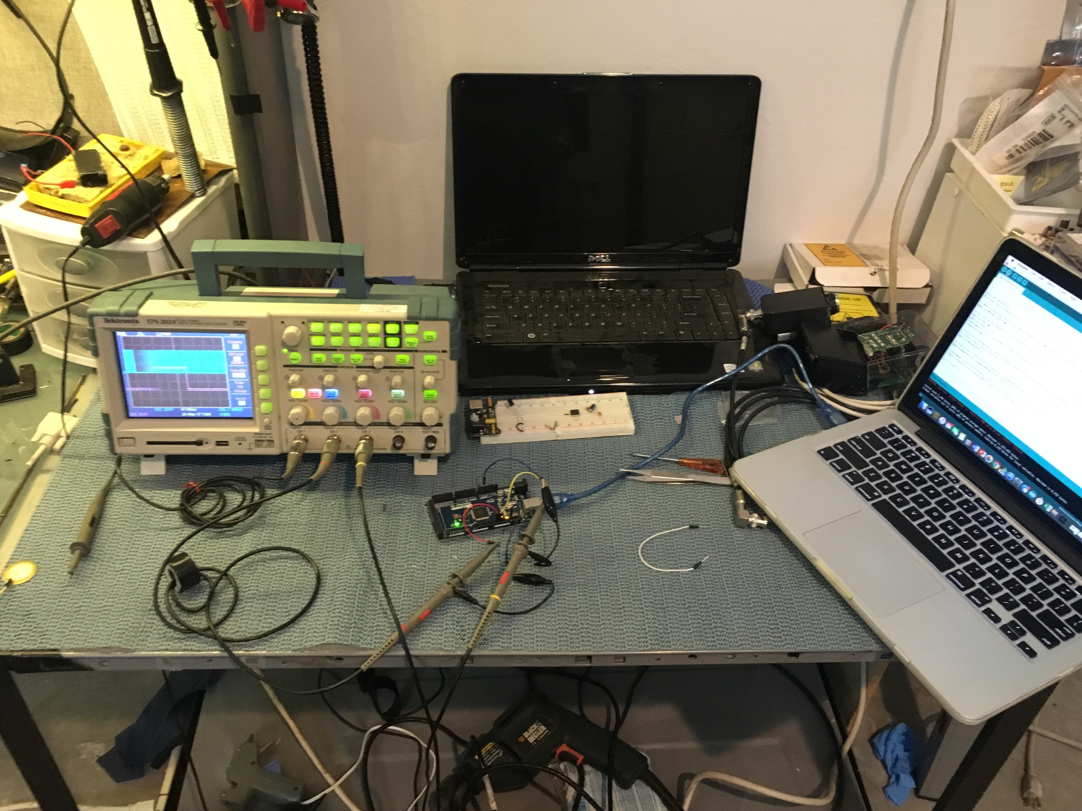
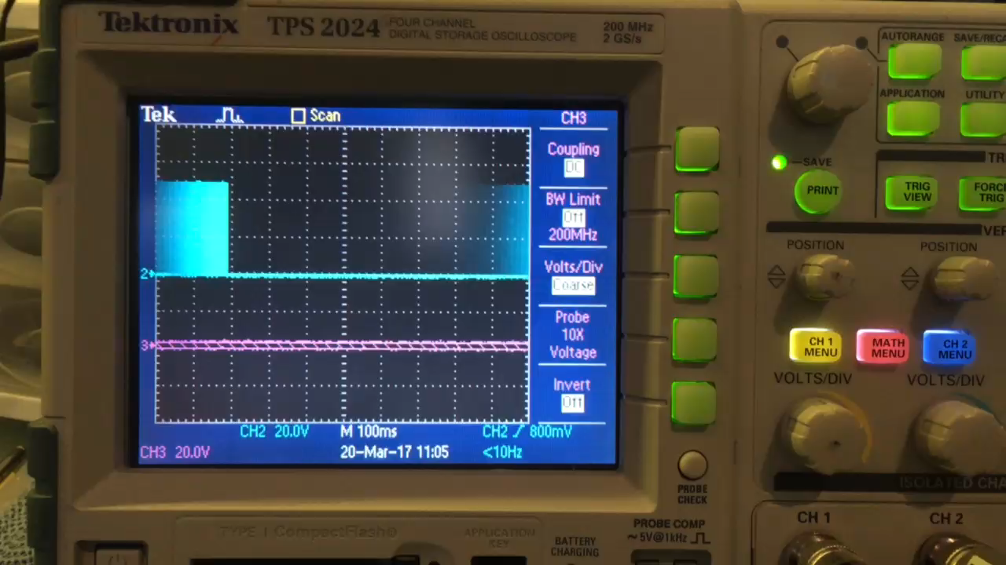
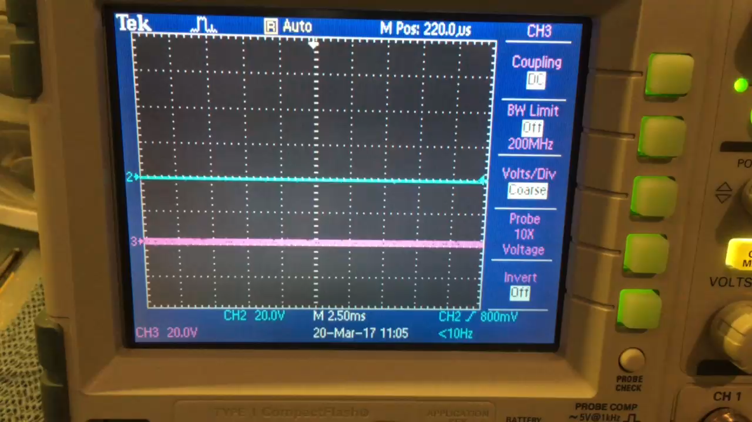
PCU bench testing
Notes:
Scope showing pulses and logic high for turning mosfets on

Slide 10
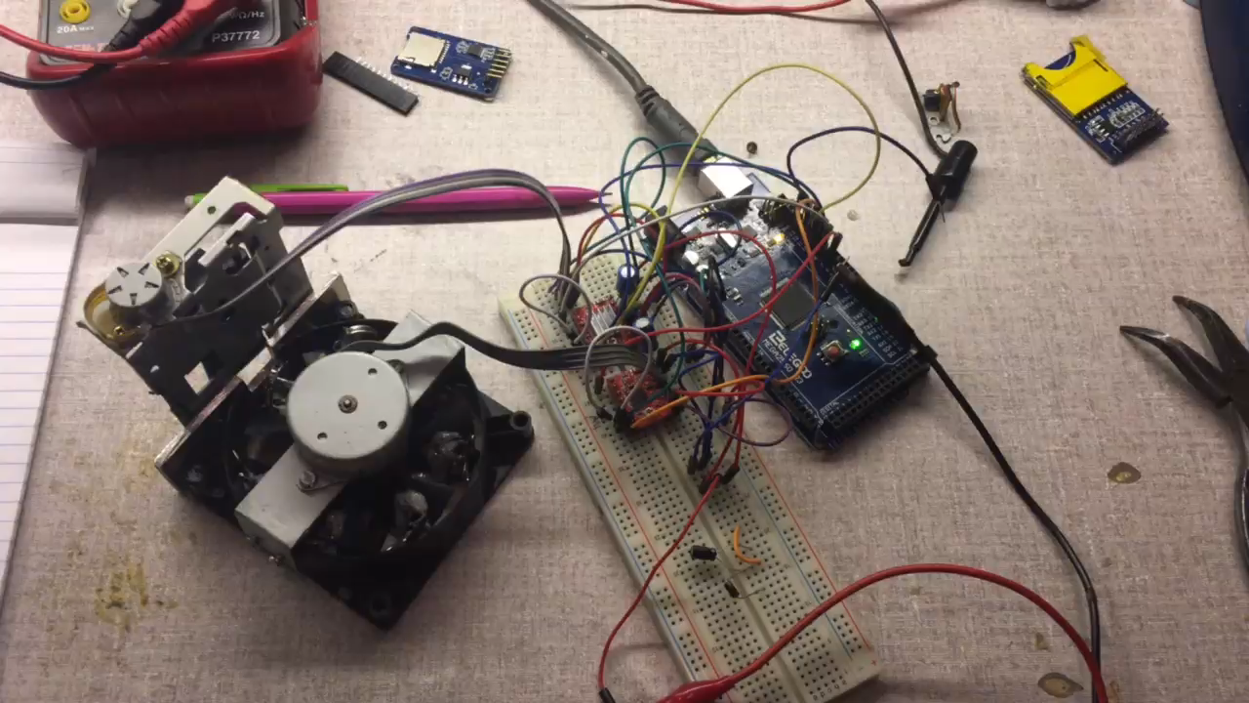
Particle Collection Unit - testing
Notes:
Explain sleep mode
Not in code but hardware

Slide 11
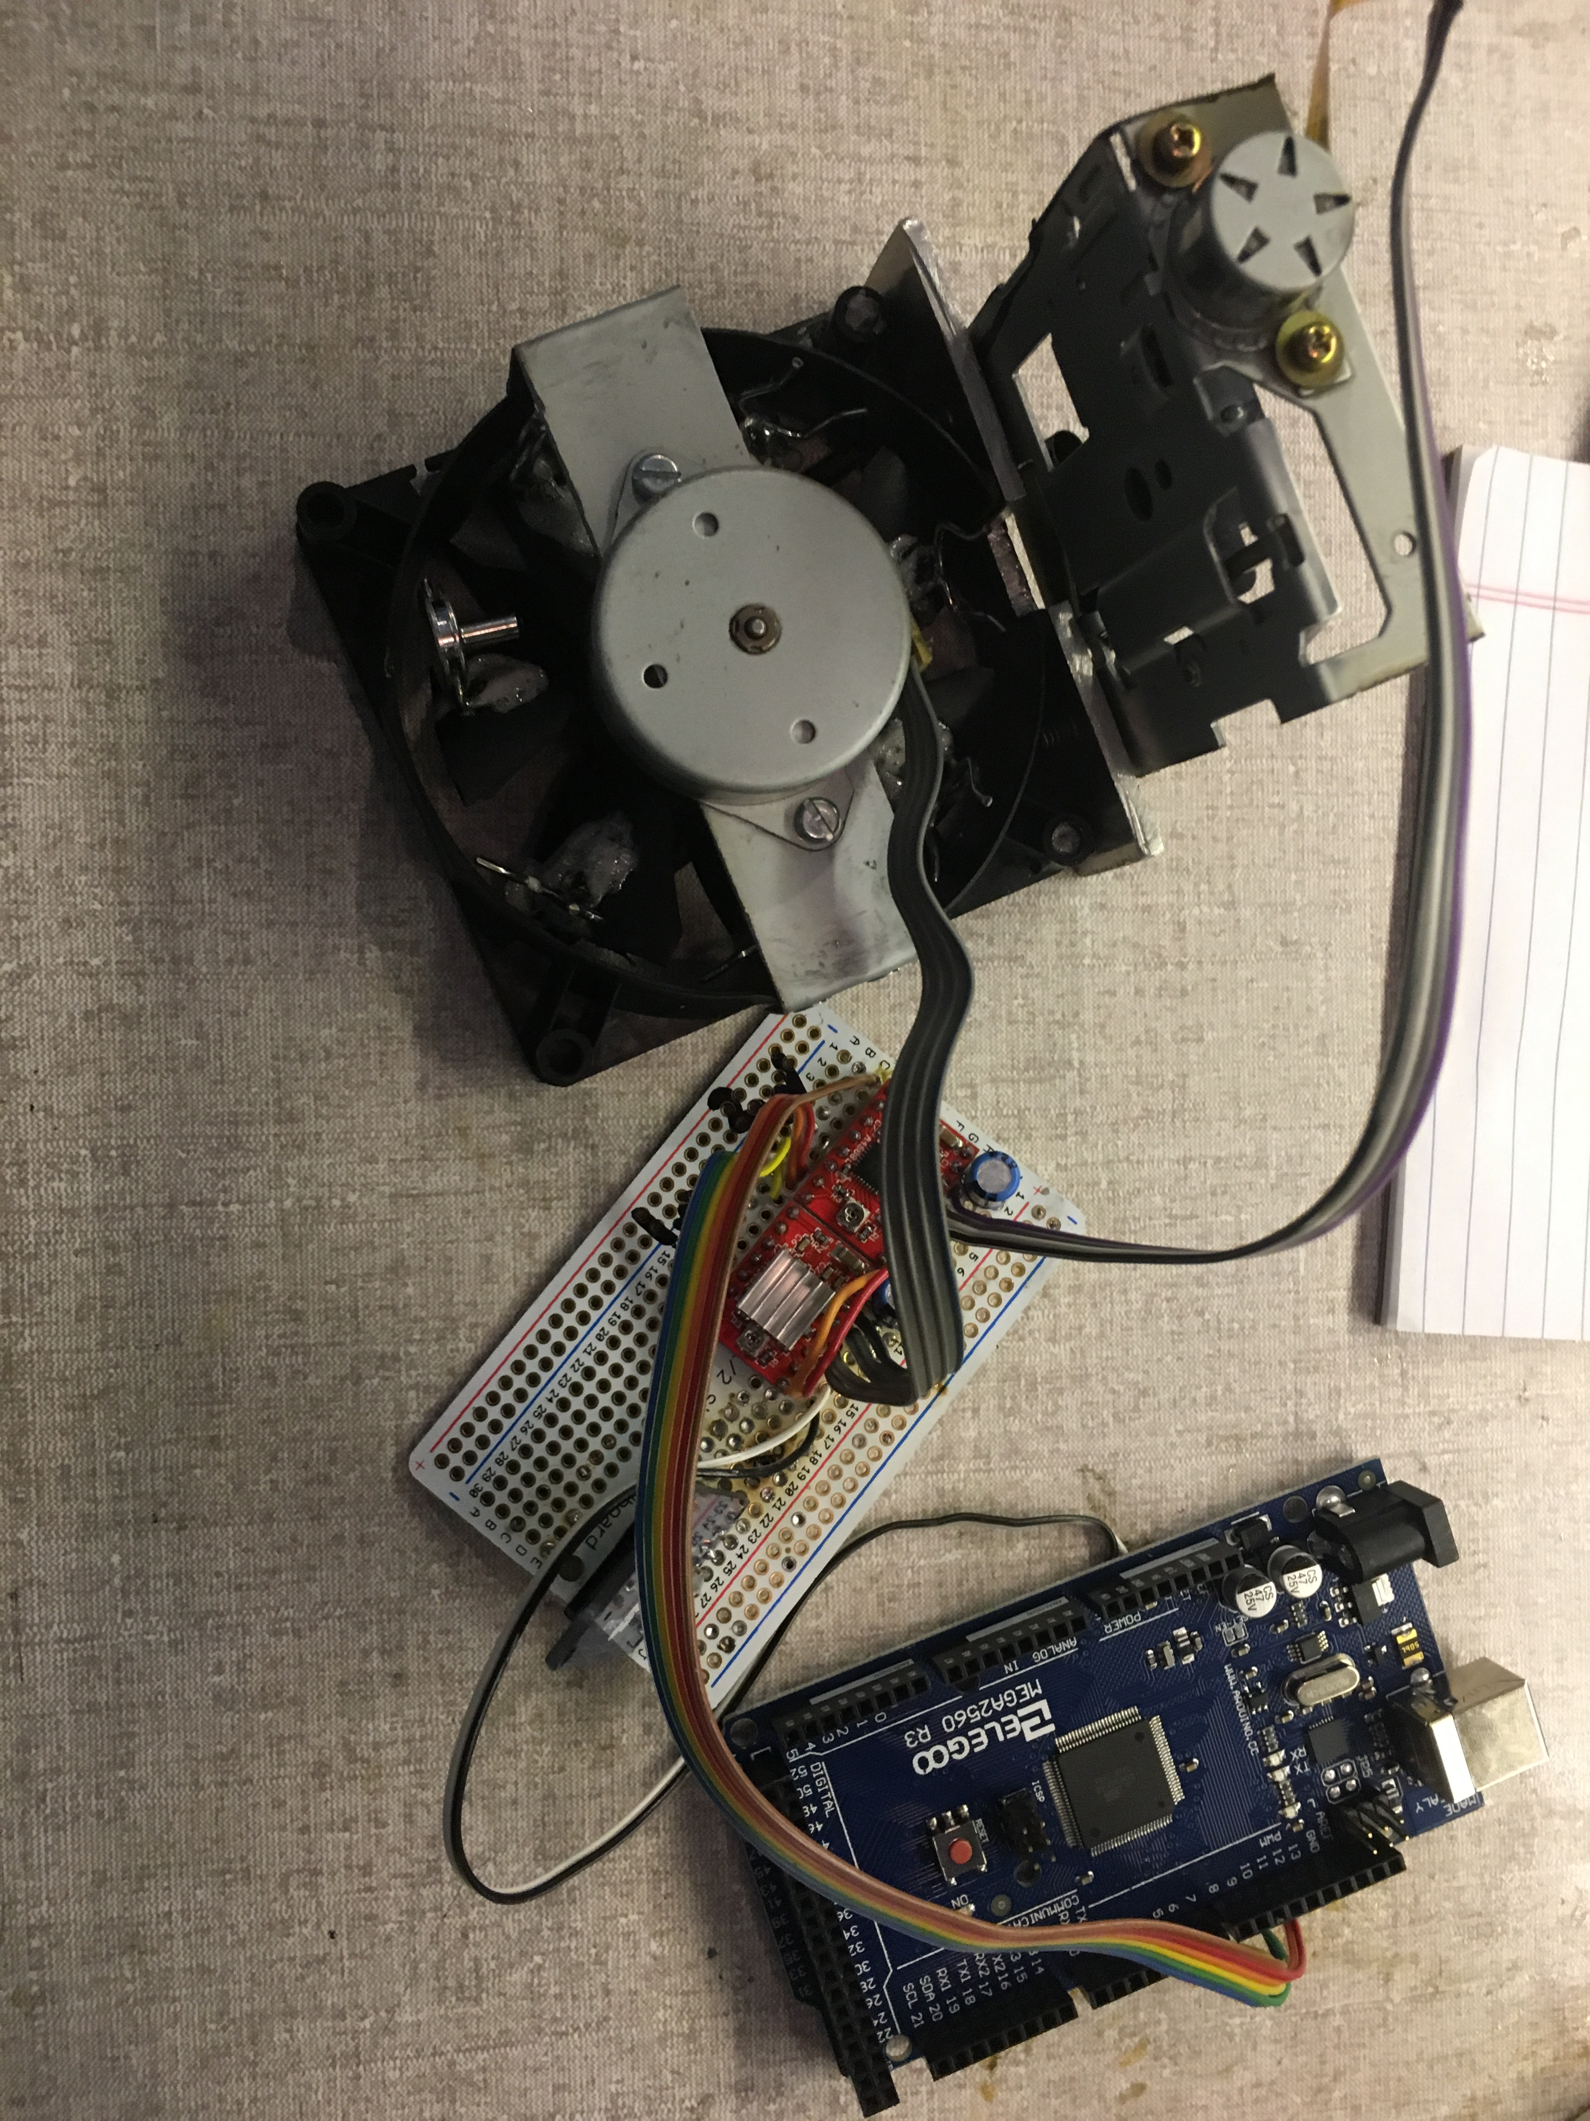
PCU Final Design
Notes:
Feedback

Slide 12
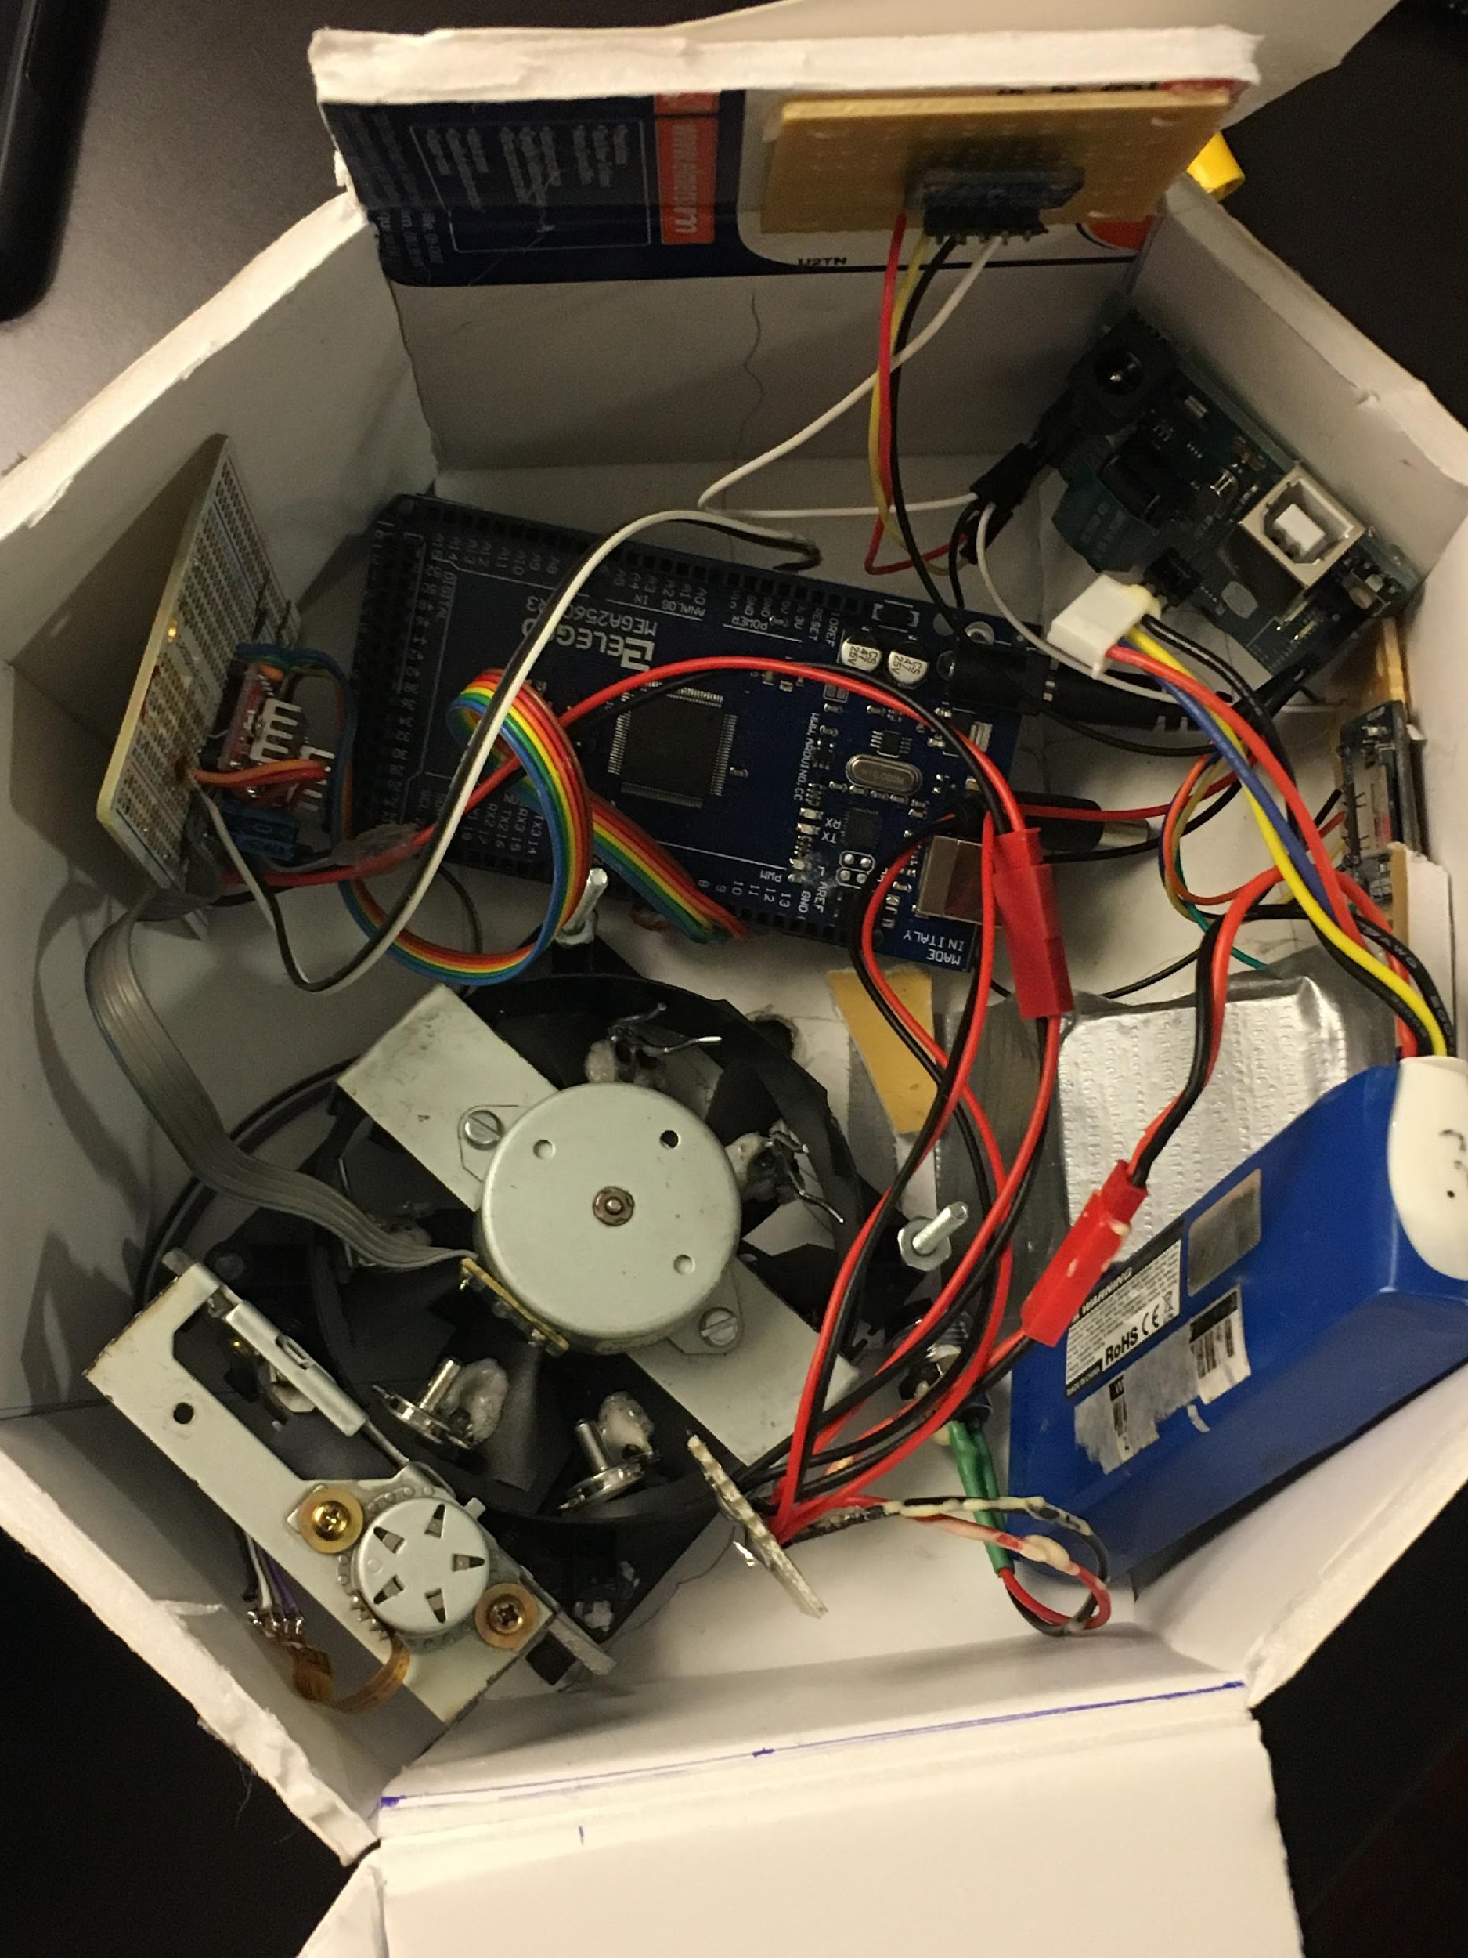
FINAL DESIGN
ARDUINO BOARDS
  Arduino Uno; Arduino Mega [WHY WE USED TWO]
TYPE OF SENSORS
  Adafruit bmp180 sensor, v.1 of programming libraries
  Adafruit microsd card breakout
TYPE OF CAMERA
  GoPro Session at 1080p resolution and 100fps
PARTICLE COLLECTOR
  Off the shelf stepper motors and linear actuator
  A4988 stepper motor drivers and associated passive components

Slide 13
FIELD TESTING: PRESSURE
Notes:
converted to mbar

Slide 14
FIELD TESTING: ALTITUDE

Slide 15
FIELD TESTING: TEMPERATURE

Slide 16
Post Flight Analysis: ANSR-105/ASCEND!
Pima Community College- West Campus
31 March, 2017
Team Members:
Alfredo Gonzalez
Tristan Simi

Slide 17
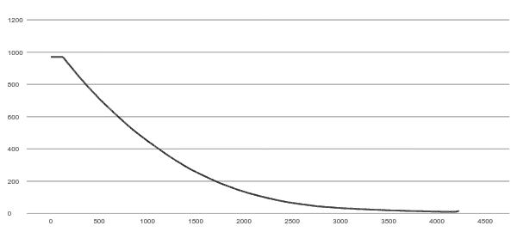
Flight Data Pressure

Slide 18
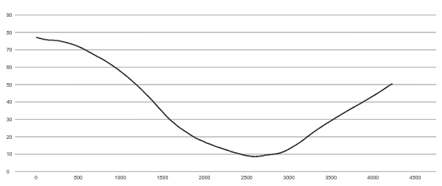
Flight Data Temperature
Notes:
compare to real data side by side

Slide 19
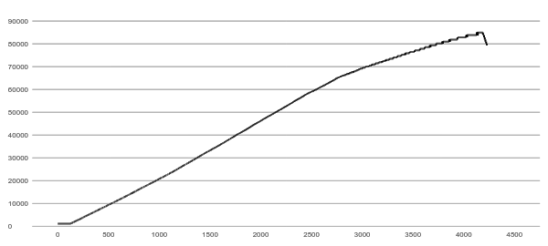
Flight Data Altitude

Slide 20
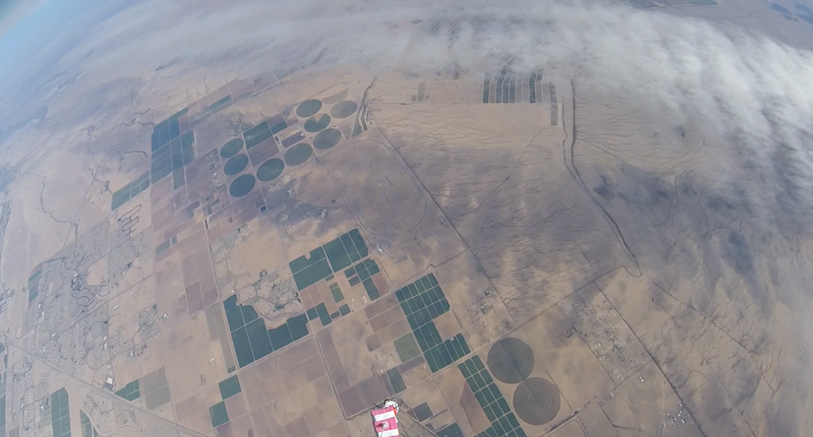

Slide 21
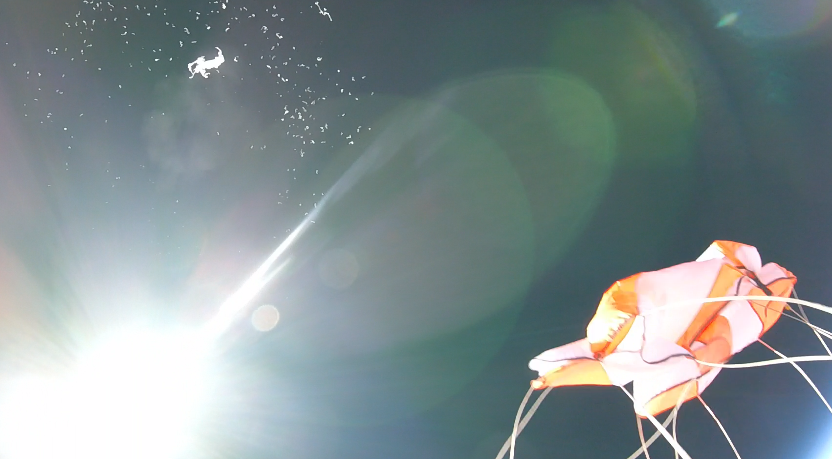

Slide 22
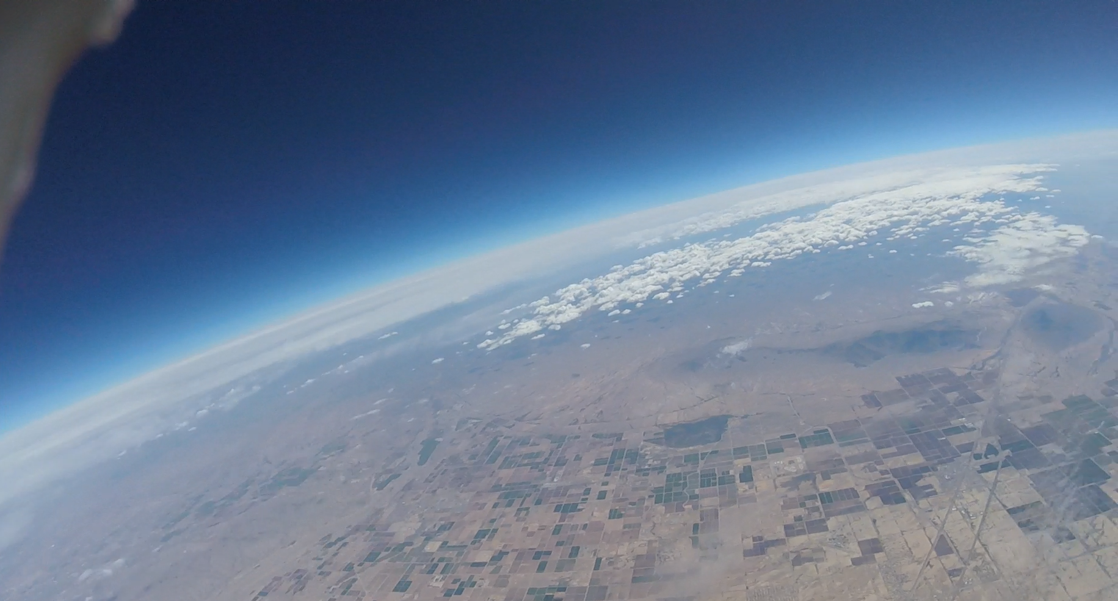

Slide 23
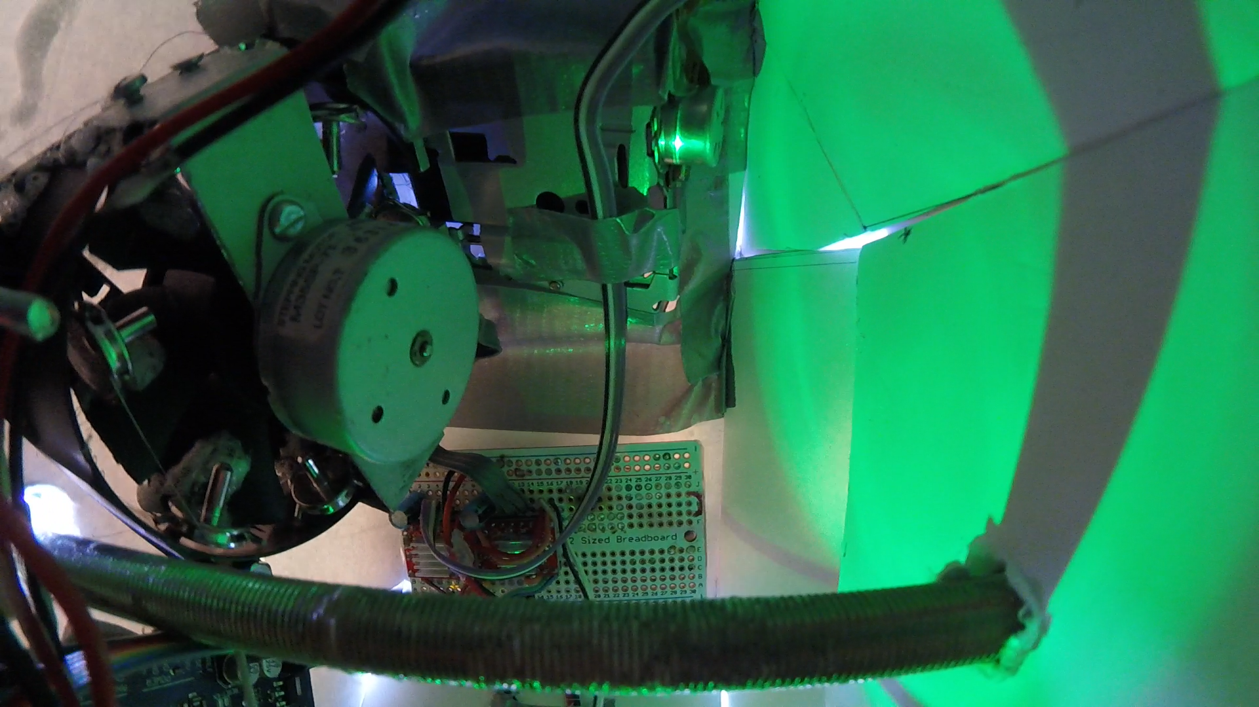

Slide 24
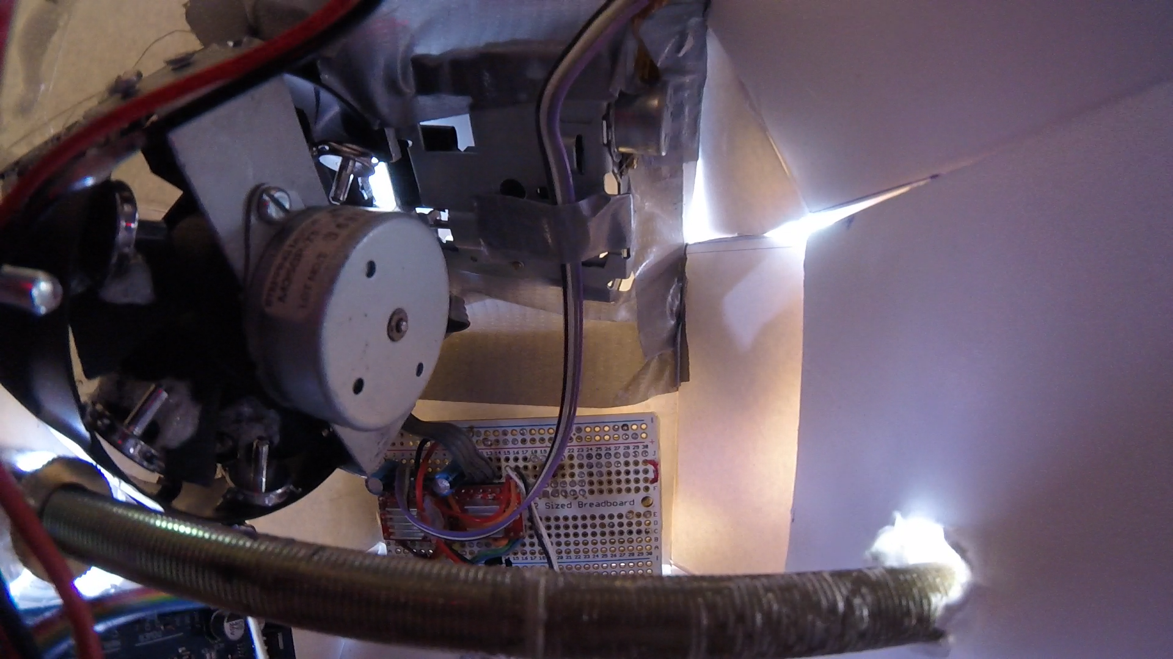

Slide 25
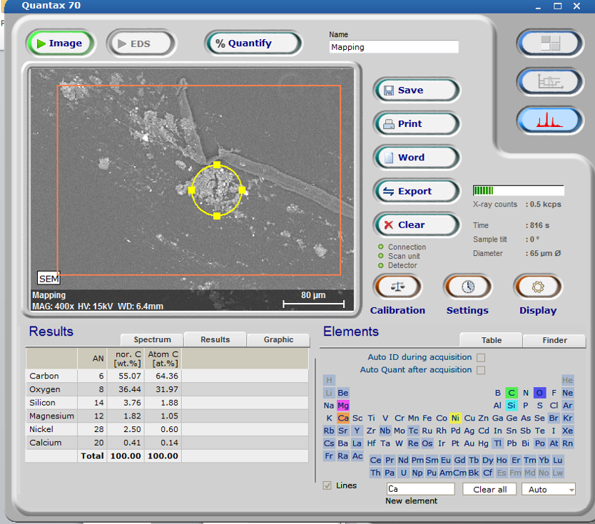
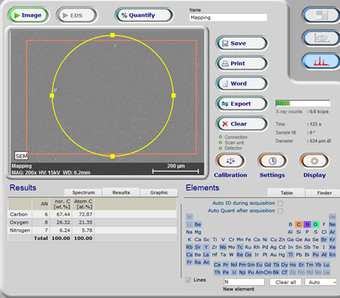
Particle Collection Data

Slide 26
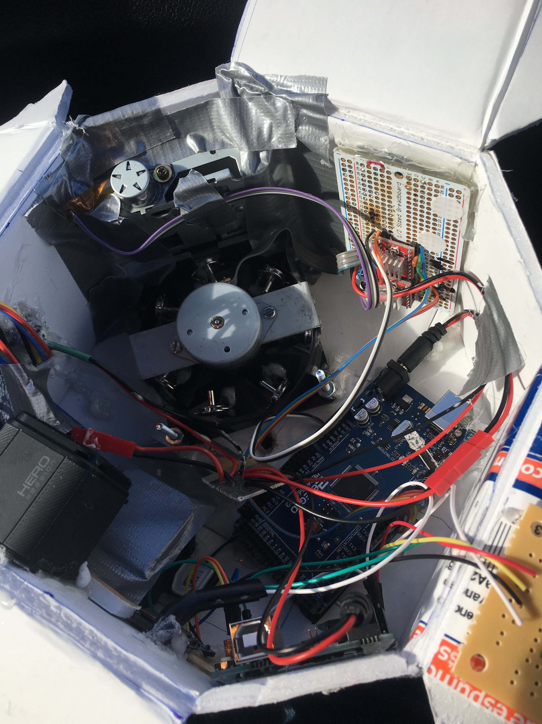
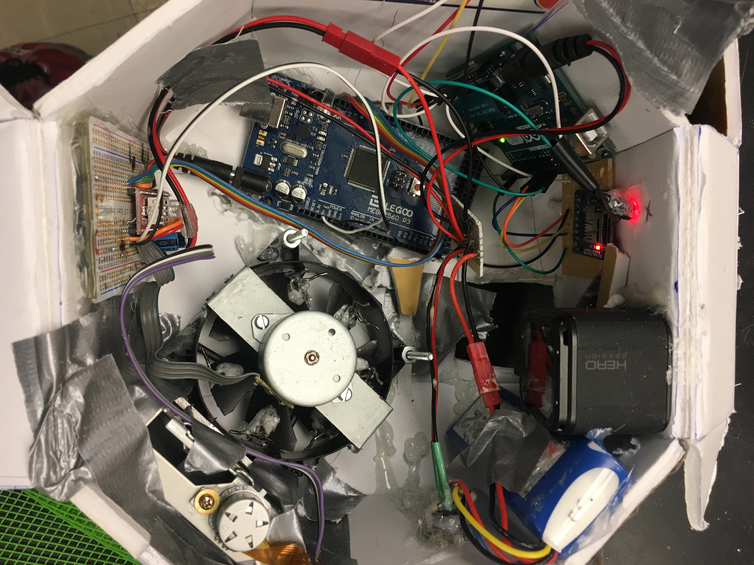
Before and after comparison of box pictures side by side

Slide 27
The Future
DIY altitude sensor
Better structural integrity
Test in cold and low pressure environment
Notes:
- DIY altitude sensor
- airtight
- reinforcements
- testing in cold and low pressure environment

Slide 28
ACKNOWLEDGMENTS
Jack Crabtree: Arizona Near Space Research
Susan Brew: Manager, Arizona/NASA Space Grant
Silvia Kolchens: Mentor, PCC West

